Slide 1
LEARNING MANAGEMENT SYSTEM WITH AI
TEAM MEMBERS:
1. ARAVINDH L (953120104006)
2. LAKSHMANAN S (953120104019)
3. MAHESH RAJA V (953120104022)
4. SARAVANA PON BALAN F (953120104044)
GUIDED BY
Mr. R. JEEVA, M. E.,
AP/CSE

Slide 2
CONTENTS
Abstract
Objective
Introduction
Literature Survey
Hardware and Software requirements
Existing System
Problem Statement
Proposed System
System Architecture
List of Modules
Expected Outcomes
References
DEPARTMENT OF COMPUTER SCIENCE AND ENGINEERING
THAMIRABHARANI ENGINEERING COLLEGE

Slide 3
ABSTRACT
A Learning Management System(LMS) is a software application or platform designed to manage, deliver, and track learning and training programs. LMS are commonly used in educational institutions, corporate settings, and other organizations to facilitate online learning and training initiatives. The existing LMS encompasses various components such as course videos, documents, e-books, and interactive quizzes for the course assessments. It lacks the interaction among the users about the contents and the absence of opportunity to contribute the knowledge by learners. For that, we have created the platform that facilitates interaction with not only mentors but also within

Slide 4
ABSTRACT(CONTD.)
learners to enhancing the overall learning journey. Users are also empowered to create courses, promoting a collaborative learning environment. Notably, the system seamlessly incorporates online compilers, allowing users to engage in practical hands-on exercises with the capability to save their work. Moreover, a bot integrated with Natural Language Processing(NLP) provides assistance by addressing relevant user queries. Additionally, implementing a recommendation system would enhance the platform by suggesting personalized courses based on user interests.

Slide 5
OBJECTIVE
To create a platform that provides user interaction, collaborative course creation, and features such as online compilers and NLP-based assistance to enhance the learning experience.
Notes:
20-02-2024

Slide 6
INTRODUCTION
An LMS (Learning Management System) is a digital platform that enables organizations to deliver, manage, and track educational content and training activities efficiently, fostering seamless learning experiences for users across various contexts.
Notes:
20-02-2024

Slide 7
LITERATURE SURVEY
[1] S. V. Phulari, Abhishek Lavale, Prajwal Gadekar, Abhishek Raut,Kishor Naykodi, “Academia : Web Platform for E-learning”, International Journal for Research in Applied Science & Engineering Technology (IJRASET) ISSN: 2321-9653; IC Value: 45.98; SJ Impact Factor: 7.538 Volume 10 Issue I Jan 2022
Description:
The application is designed for interaction among students and teachers. Its unique feature is streamlined departmental management, facilitating information sharing between teachers and students.

Slide 8
LITERATURE SURVEY
[2] Sawsan Al-Skaf, Khadija Alhumaid, Enaam Youssef, Mohammed Habes and Said A. Salloum, “The Acceptance of Social Media Sites: An Empirical Study Using PLS-SEM and ML Approaches”, AMLTA 2021, AISC 1339, pp. 548–558, 2021.
Description:
Model for Pupils' Acceptance of Social Media in Education, United Arab Emirates University Students. Technology Acceptance Model (TAM) extended with social influence. Data from 350 students analyzed using Machine Learning (ML) and Partial Least Squares Structural Equation Modeling (PLS-SEM), highlighting social influence, usefulness, and ease of use

Slide 9
LITERATURE SURVEY
[3] Nouf S. Aldahwan, Nourah I. Alsaeed, “Use of Artiﬁcial Intelligent in Learning Management System (LMS): A Systematic Literature Review”, International Journal of Computer Applications (0975 – 8887) Volume 175– No. 13, August 2020
Description:
LMS, with Artificial Intelligence (AI) integration, enhances education but lacks customization. The paper explores AI solutions in LMS, addressing issues and building intelligent learning environments, with future work focusing on architecture and model details.

Slide 10
HARDWARE AND SOFTWARE REQUIREMENTS
HARDWARE REQUIREMENTS:
RAM : Minimum 4GB
Hard Disk : Minimum 80GB
SOFTWARE REQUIREMENTS:
IDE : VSCode
Frontend : React.js
Backend : Express.js, MongoDB

Slide 11
EXISTING SYSTEM
The current educational landscape primarily relies on conventional LMS with limited technological integration, lacking advanced features like AI-driven personalization, virtual assistants, comprehensive assessment, integrated online compilers and robust data security measures.

Slide 12
PROBLEM STATEMENT
The existing LMS often lacks key features that hinder a collaborative and interactive learning experience. Users are typically restricted in their ability to engage with and learn from each other. Additionally, users cannot easily share their knowledge, experiences, or insights, which limits the platform's potential as a community for learning.

Slide 13
PROPOSED SYSTEM
The proposed system seeks to modernize education by integrating AI into the LMS, introducing features such as personalized recommendations, an AI powered virtual assistant, mentor interaction, user-generated courses, share post and online compilers. This forward-looking LMS aims to adapt to the "new normal" by offering a comprehensive learning environment tailored to the evolving needs of learners in a rapidly changing world.

Slide 14
SYSTEM ARCHITECTURE
Compiler
LMS
Profile
extraction
Learning room
Code Craft repository
Learner
Recommendation System
User
Course suggestion
Course resources
Course repository
Mentor
User repository
Course creation

Slide 15
MODULES
User Management:
Profile: View and manage your account details, progress, and achievements.
Chat: Directly communicate with mentors or content creators for support and guidance.
Chat Assistant: Get assistance with technology-related queries from an AI chatbot.
Notifications: Receive updates on course enrollments, messages, and other relevant activities.

Slide 16
MODULES
Course Management:
Access and participate in learning modules or create your own courses.
Feed: Share updates, achievements, and engage with others on the platform.
Progress Tracking: Monitor your progress within courses, track completed modules, and set learning goals.
Collaboration Tools: Collaborate with peers on projects, assignments or discussions within courses.

Slide 17
MODULES
CodeCraft:
Practice coding in programming such as Python and Node.js related to the course assessments.
Store code snippets for future reference and practice sessions.

Slide 18
MODULES
Recommendation System:
Utilize content-based filtering technique to recommend courses and learning materials based on the user's past interactions, preferences, and the content similarity of courses.
It analyzes the content of courses, modules, and resources to understand their topics, difficulty levels, and relevance to specific skills or interests.

Slide 19
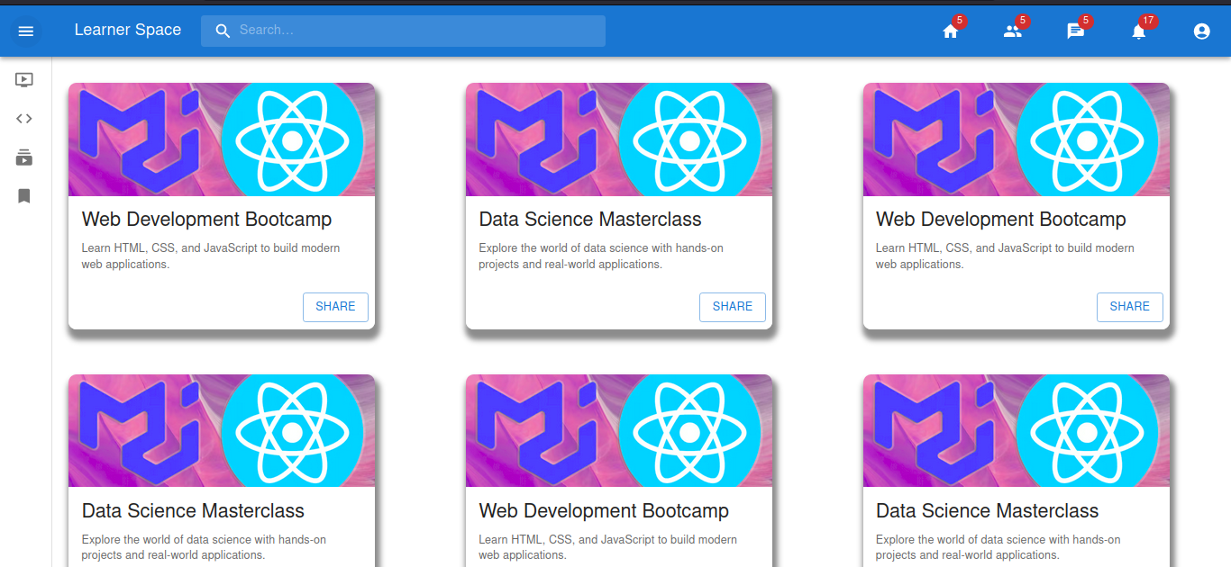
EXPECTED OUTCOME
Figure 2 : Course list

Slide 20
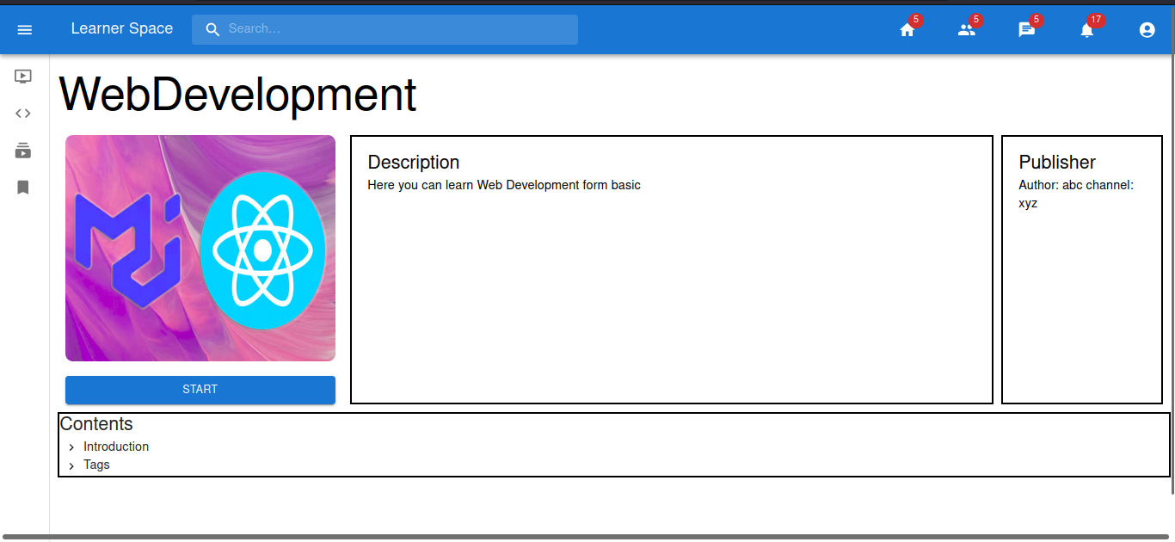
EXPECTED OUTCOME
Figure 3: Course dashboard

Slide 21
REFERENCES
[1]
[2]
[3]
S. V. Phulari, Abhishek Lavale, Prajwal Gadekar, Abhishek Raut, Kishor Naykodi, “Academia : Web Platform for E-learning”, ISSN: 2321-9653, Volume :10, Issue : 1, pp: 284-290, January 2022.
Sawsan Al-Skaf, Khadija Alhumaid, Enaam Youssef, Mohammed Habes, and Said A. Salloum, “The Acceptance of Social Media Sites: An Empirical Study Using PLS-SEM and ML Approaches”, AMLTA 2021, AISC 1339, pp. 548–558, 2021.
Nouf S. Aldahwan, Nourah I. Alsaeed, “Use of Artificial Intelligent in Learning Management System (LMS): A Systematic Literature Review”, International Journal of Computer Applications (0975 – 8887) Volume 175– No. 13, August 2020

